Slide 1
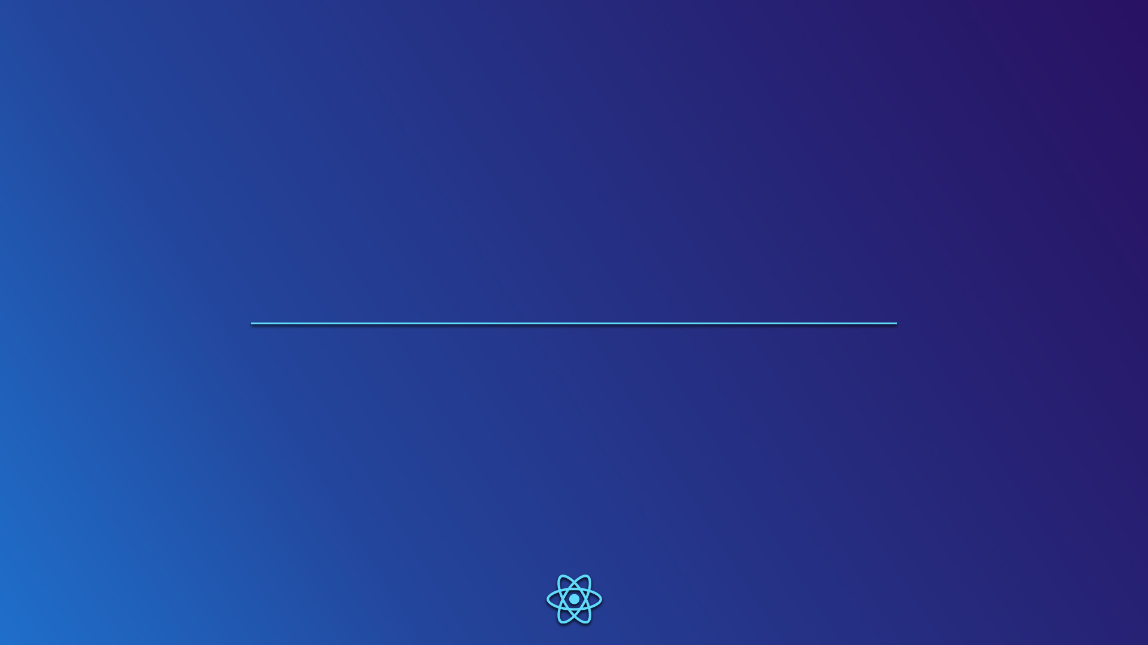
React
JavaScript library
Presentation by Diogo Correia

Slide 2
What is React?
React is a JavaScript library for front-end development.
React presents the following features:
Declarative view
Components
User Interface
React makes it easier to create UIs through it's declarative programming views, in a way that you have to say what you want, not how you want it.
React uses a technique of dividing the code into encapsulated components, making use of Object-oriented Programming with JavaScript's classes.
Each component renders a piece of HTML code, with actual HTML syntax, avoiding the painful functions from the document, in JavaScript, to manipulate elements.

Slide 3
How does React work?
Setup
To setup React locally, it is used NodeJS package manager (NPM).
By running the following command
npx create-react-app my-app
you create a development environment.
When inside the app directory, the app will be running on localhost after running the command
npm start
The .js files should start with
import React from 'react';
import ReactDOM from 'react-dom';
import './index.css';
in order to gain access to the necessary classes and methods.

Slide 4
How does React work?
Writing code
As stated previously, React code is based on components .
{
can be seen as a section of the interface;
can have children components, which can receive information from its parent through props;
the information in each component is stored in states.
The document is rendered a first time using ReactDOM.render and by “passing” the component which renders the first document elements. To update the stored data in a certain component and re-render the interface, you can either use the function setState() or, if that component doesn’t have a state, you can just use the function forceUpdate().

Slide 5
How does React work?
Writing code
- Tic tac toe
class Board extends React.Component {
constructor(props) {
...
}
renderSquare(i) {
return (
<Square
value={this.state.squares[i]}
onClick= {() => this.handleClick(i)}
/>
);
}
}
class Square extends React.Component {
render() { // renders specific elements
return (
<button
className="square"
onClick={() => this.props.onClick()}
>
{this.props.value}
</button>
);
}
}
child
parent
From React tutorial @https://reactjs.org/

Slide 6
How does React work?
In the interaction that we just saw in the previous slide between Board and Square, we are passing down two props from Board to Square: value and onClick.
Board is keeping an array squares with the information of the data in each square of the tictactoe game. It also has a function that deals with a click event, handleClick(). Square uses handleClick() to fill the clicked position in squares, and then uses squares to get the value that was just filled by the click handler, either ‘X’ or ‘O’, and then writes it in the <button>.
To be more specific…

Slide 7
Why React?
React makes UI updates a much easier and more intuitive job.
There is a very good connection between parent a children components, making it easy to access values within one another through props or callback functions.
Parent
component
passing data
Child
component
Parent
component
passing data
Child
component
}
}
usage of props
usage of callback functions

Slide 8
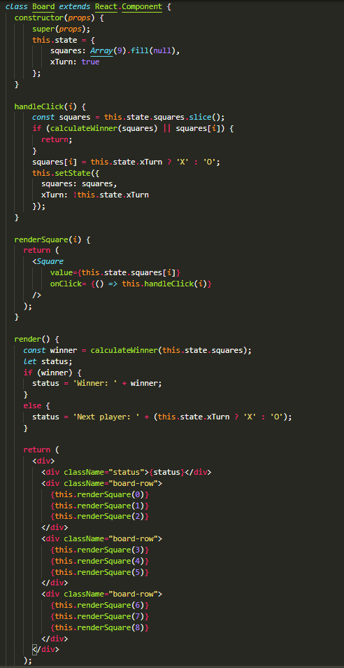

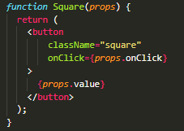
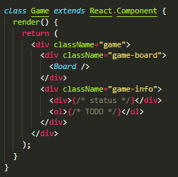
Code examples
1
Tic-tac-toe
Doesn’t need to be a class because it is just returning
From React tutorial @https://reactjs.org/

Slide 9
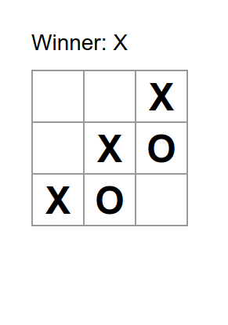
Code examples
1
Tic-tac-toe

Slide 10
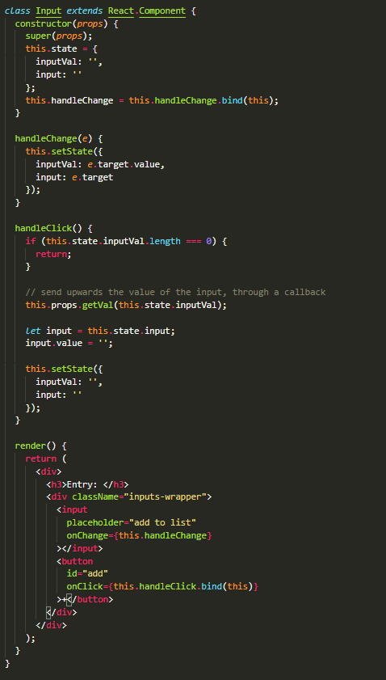
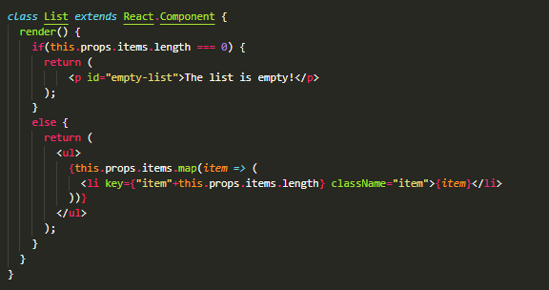

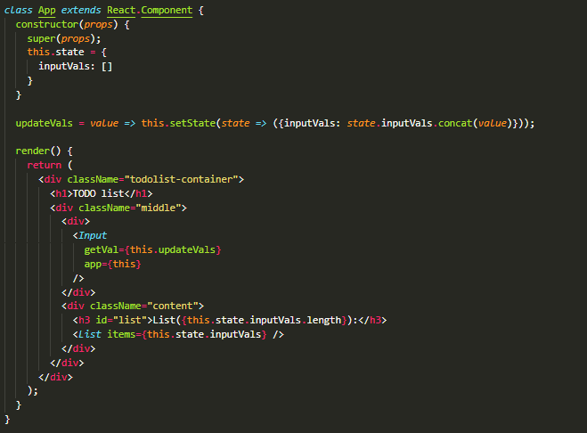
Code examples
2
TODO list

Slide 11
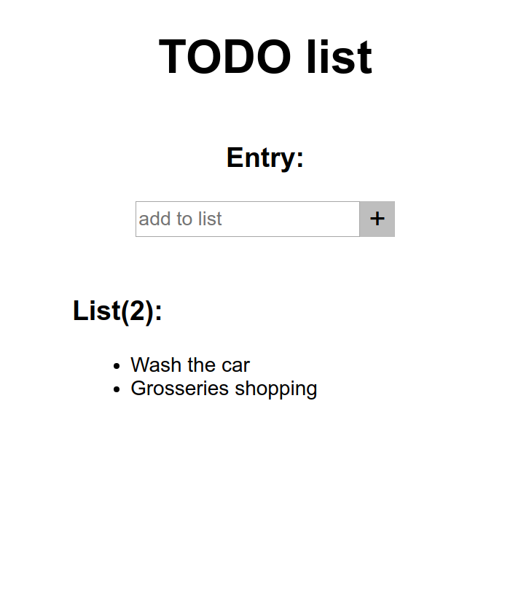
Code examples
2
TODO list

Slide 12
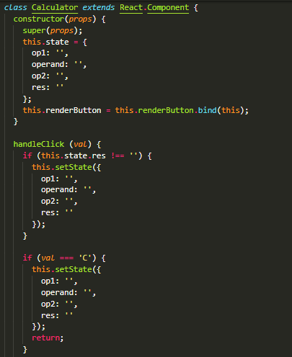
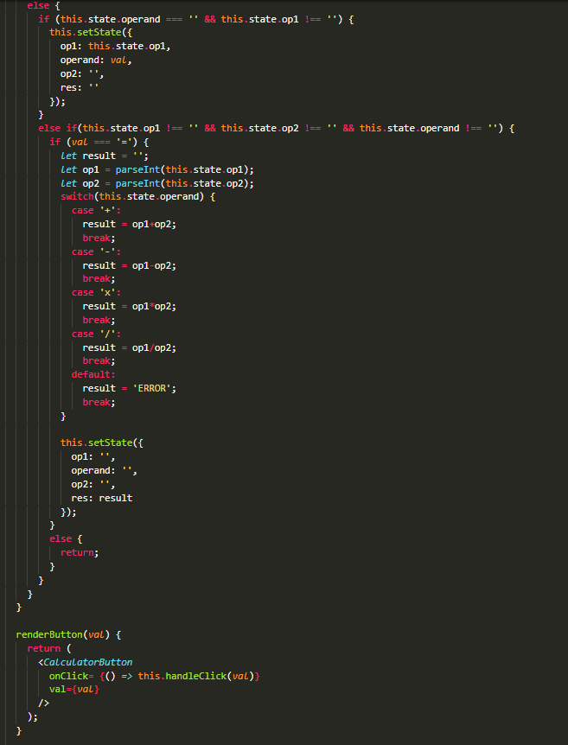

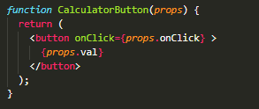
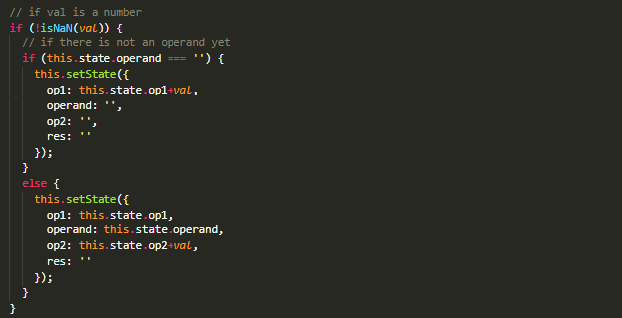
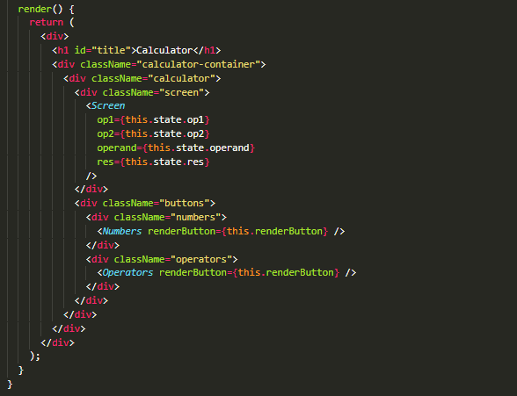
Code examples
3
Calculator

Slide 13
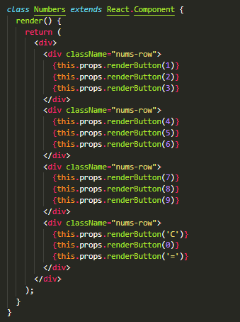
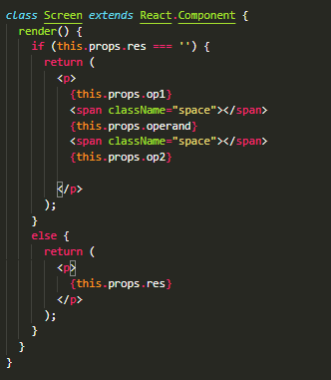
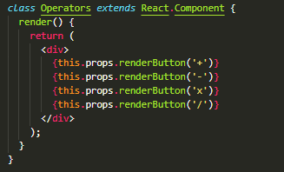
Code examples
3
Calculator
…

Slide 14
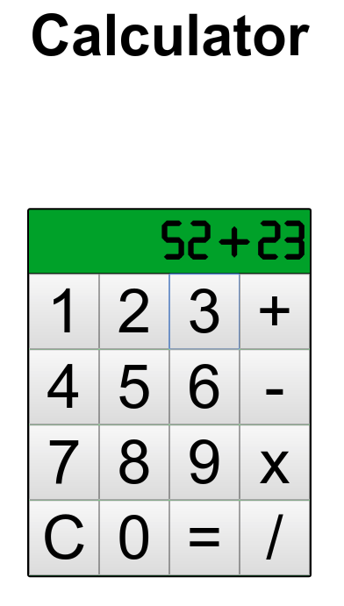
Code examples
3
Calculator

